Slide 1
The Implement of Cartoon GAN
資工111 劉子弘

Slide 2
Agenda
01
02
03
04
Introduction
Model
Architecture
Loss & Initialize
Train & Results

Slide 3
01
Introduction

Slide 4
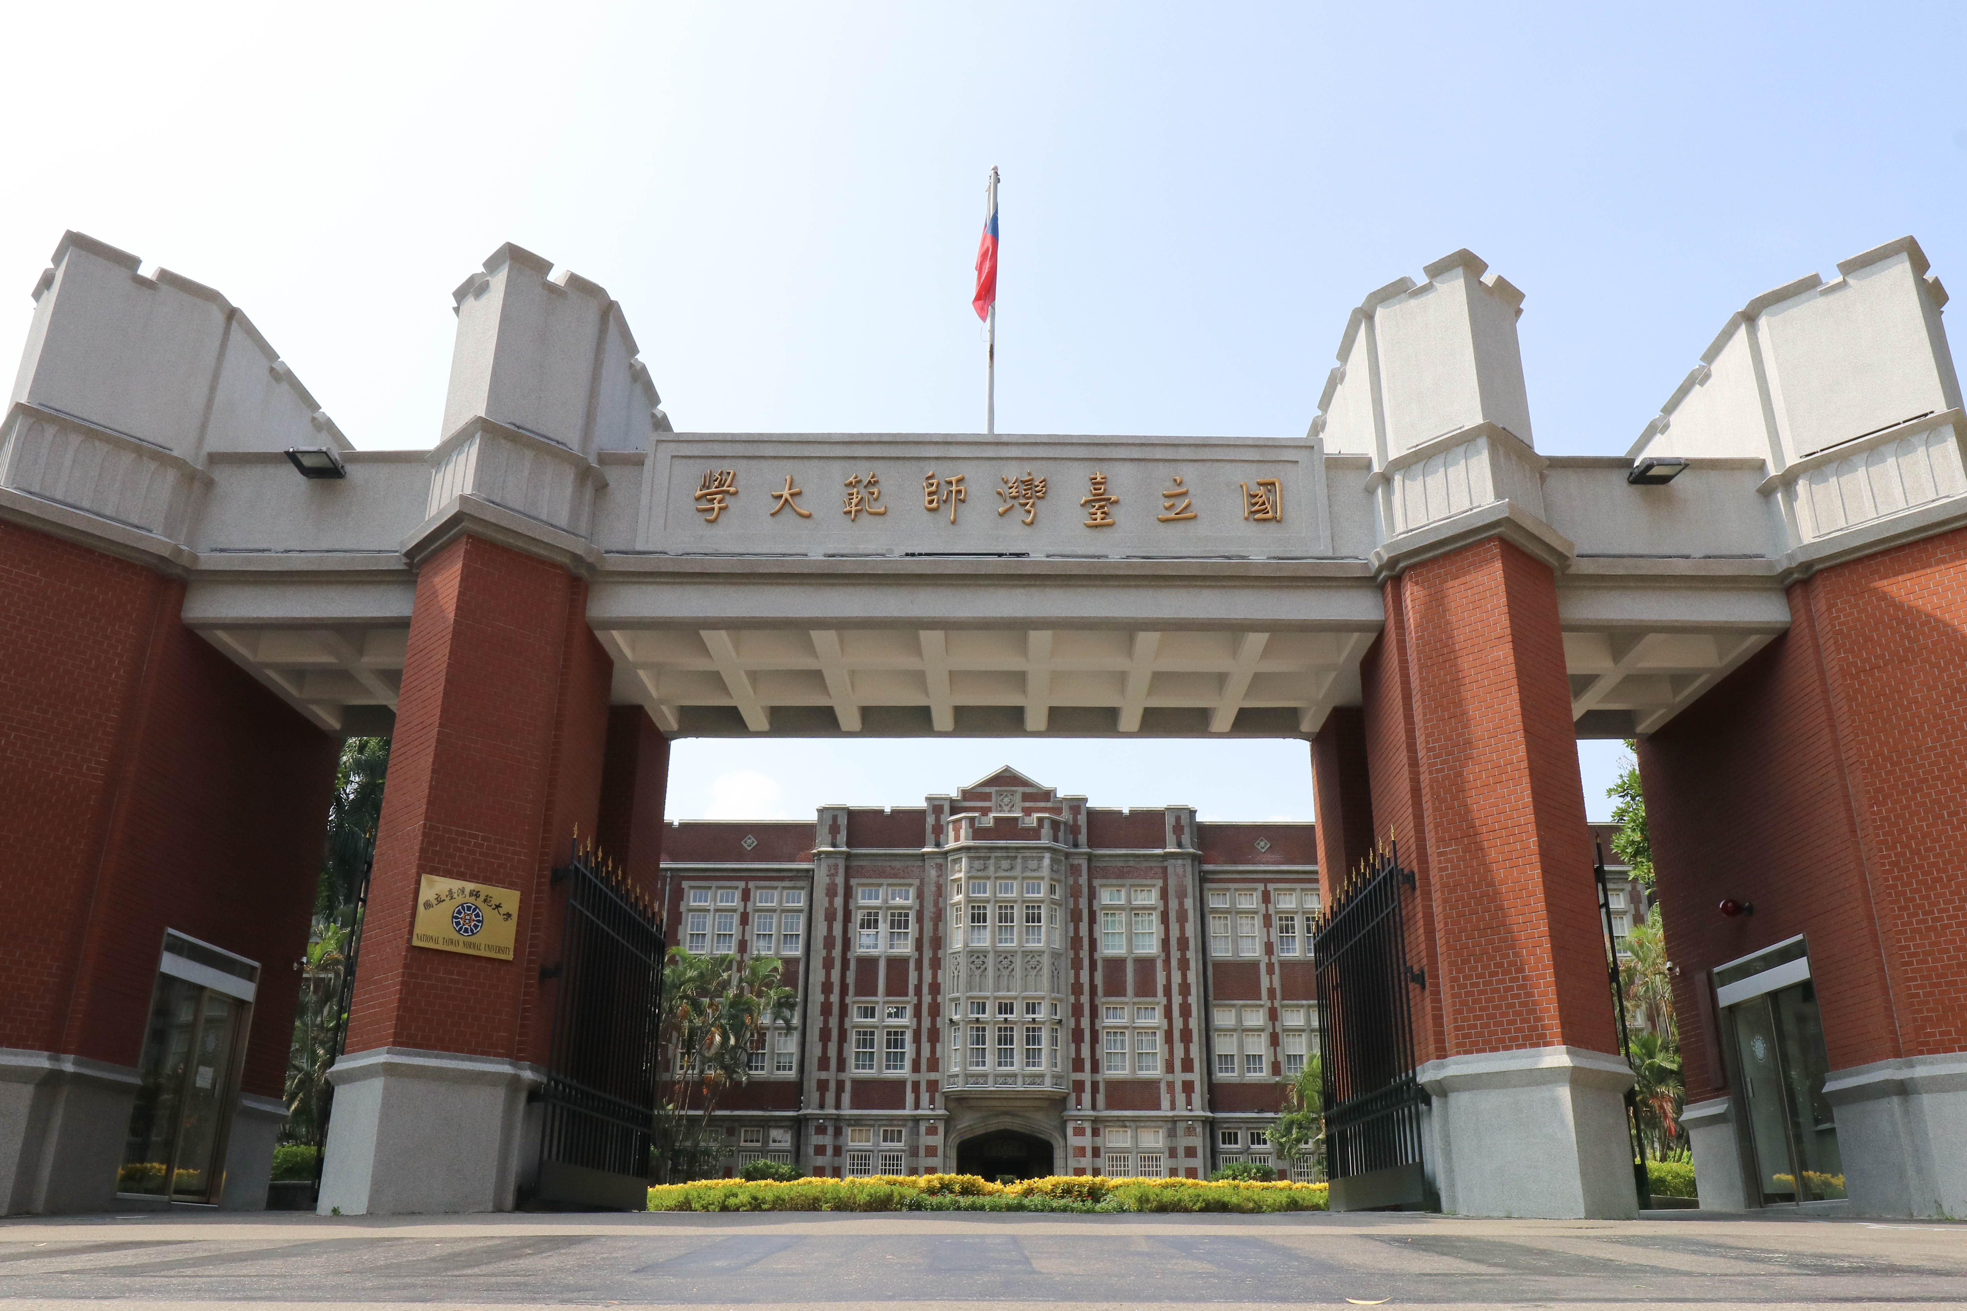
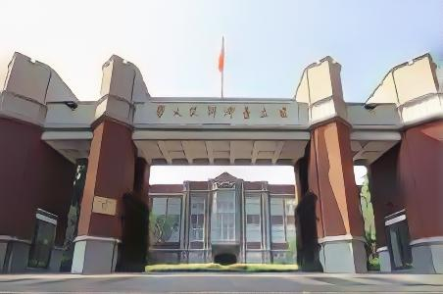
Cartoon GAN
CVPR 2018
CartoonGAN: generative adversarial networks for photo cartoonization
by Yang Chen,Yu-Kun Lai,Yong-Jin Liu

Slide 5
Cartoon GAN
Data set
Animator style
Loss Funtion
Initialization

Slide 6
02
Model Architecture

Slide 7
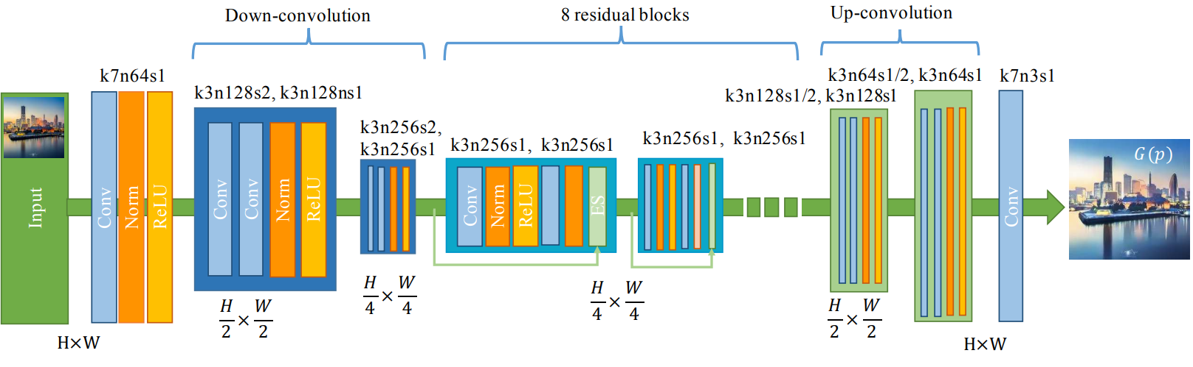
Generator

Slide 8
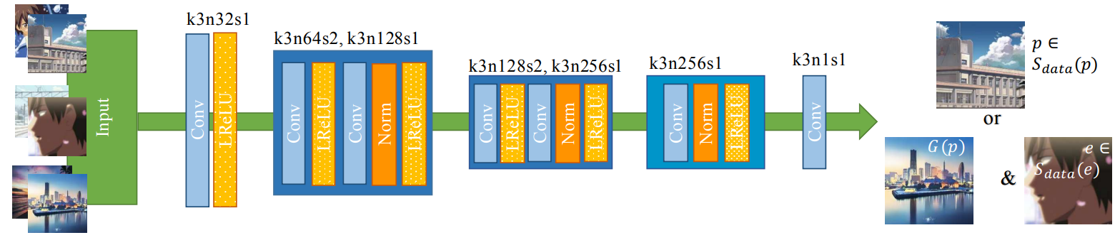
Discriminator

Slide 9
03
Loss & Initialize

Slide 10
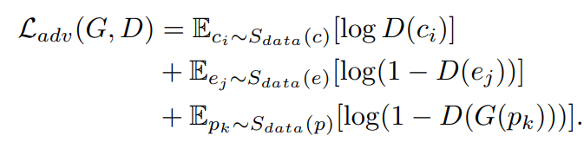
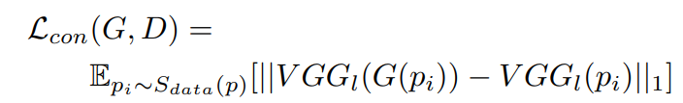
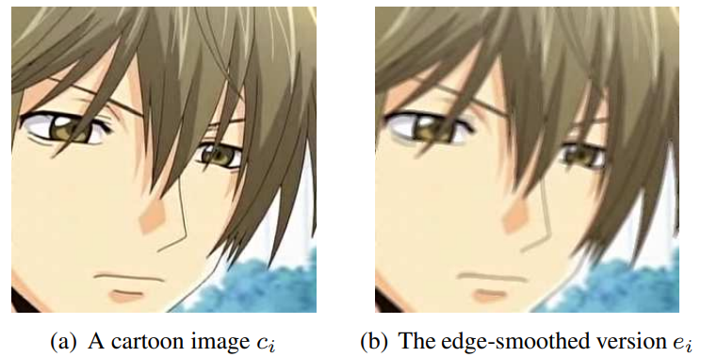
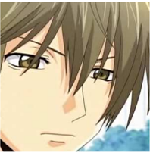
Loss Funtions
Adversarial loss
Content loss

Slide 11
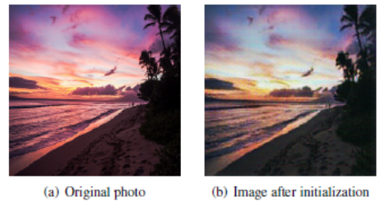
Initialization phase

Slide 12
04
Training & Results

Slide 13
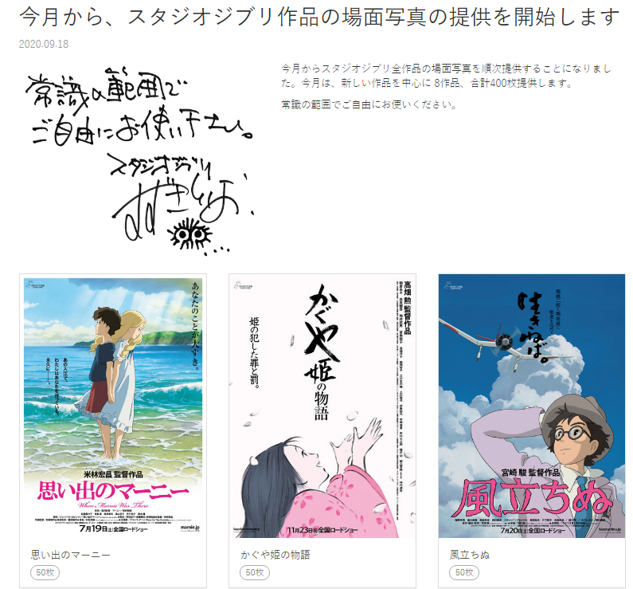
Data set
8 movies
50 pictures per movie

Slide 14
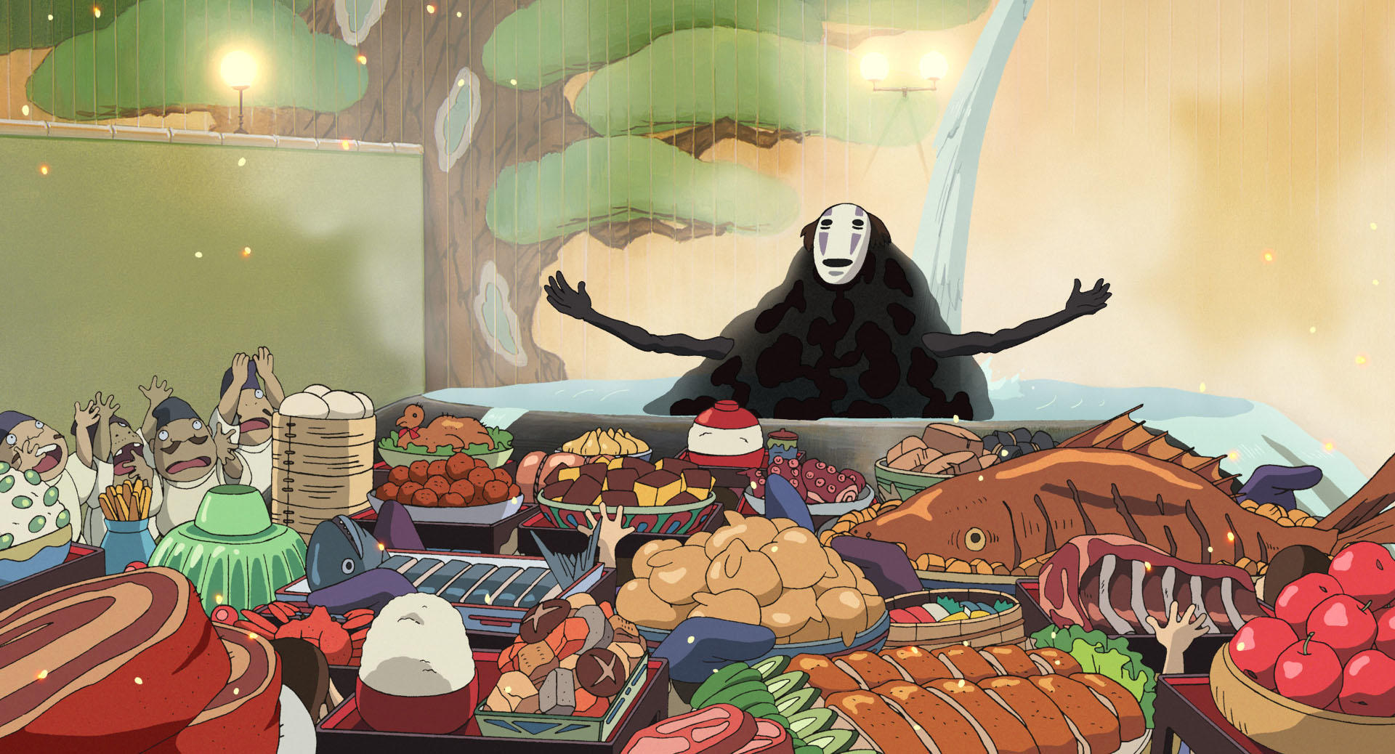

Data set-edge smoothed

Slide 15
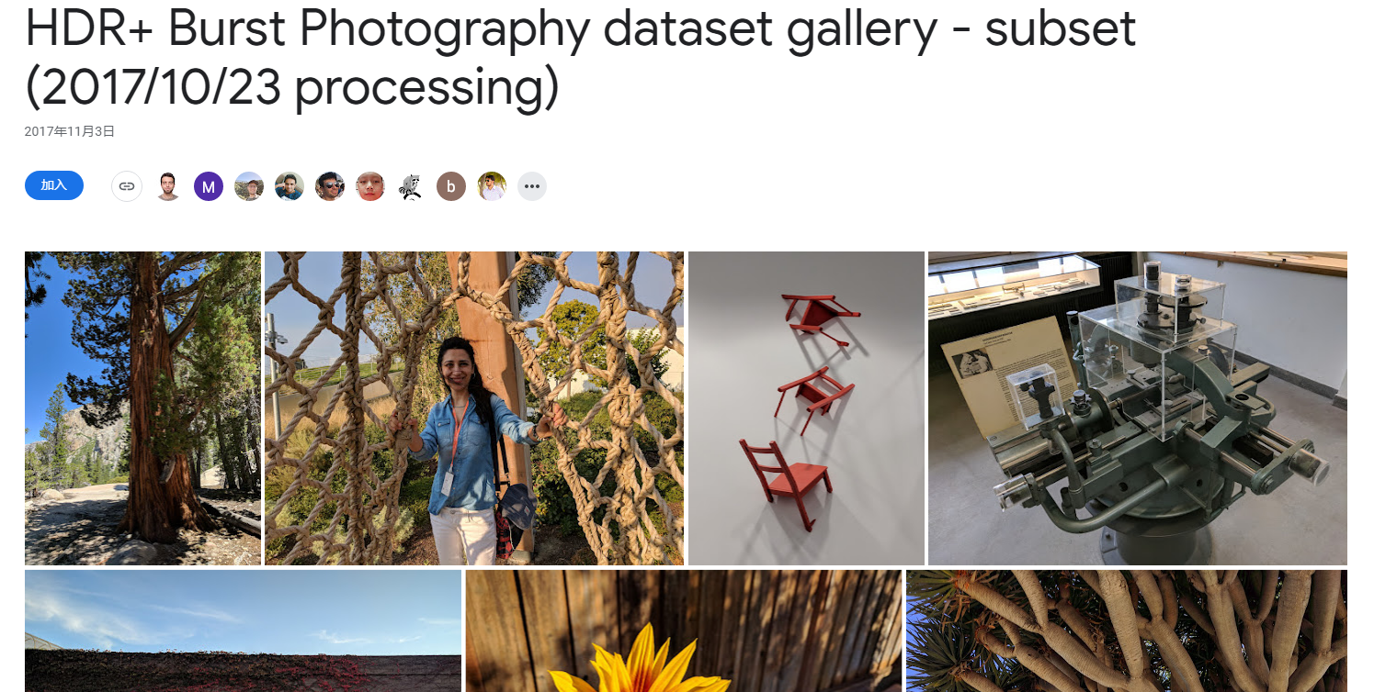
Data set
145 trainig ,8 testing

Slide 16
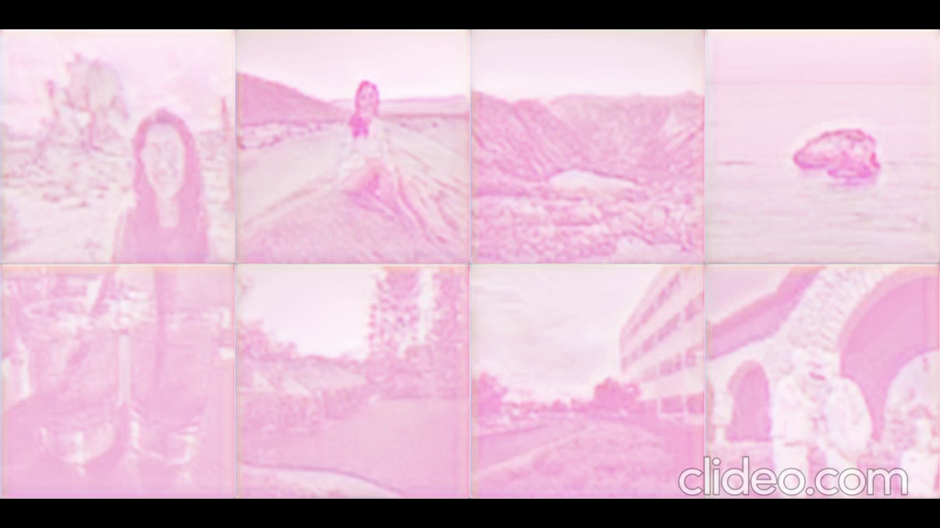
Training
GTX1050ti,16GB ram
Tensorflow 2,Keras
100 epochs ,90s per epoch
Batch sizes 32 -> 16 -> 8 -> 4 -> 2 -> 1… work!
Open source exported model！

Slide 17
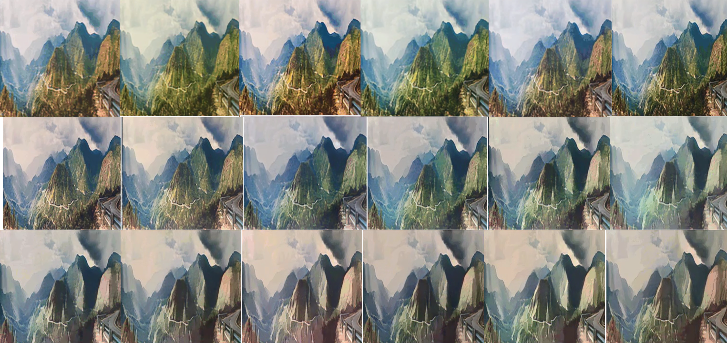
Training

Slide 18
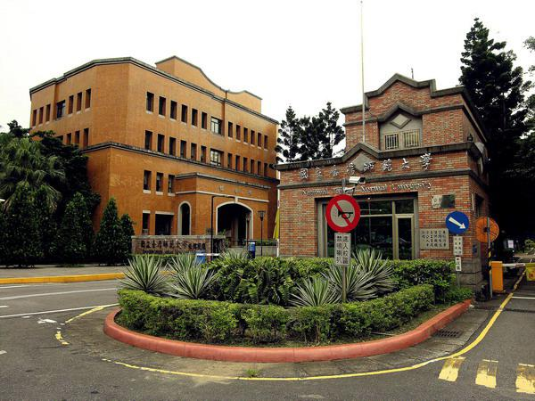
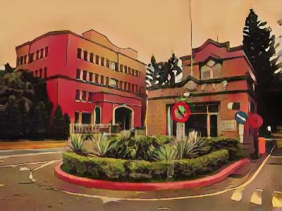
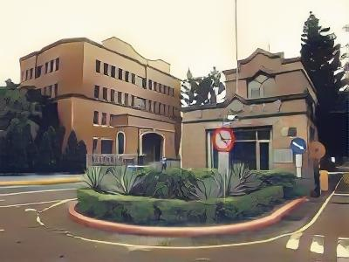
Original
Results
宮崎駿 ver.
新海誠 ver.

Slide 19
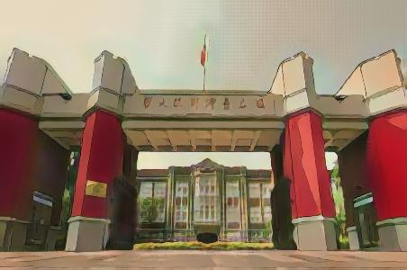
Original
Results
宮崎駿 ver.
新海誠 ver.

Slide 20
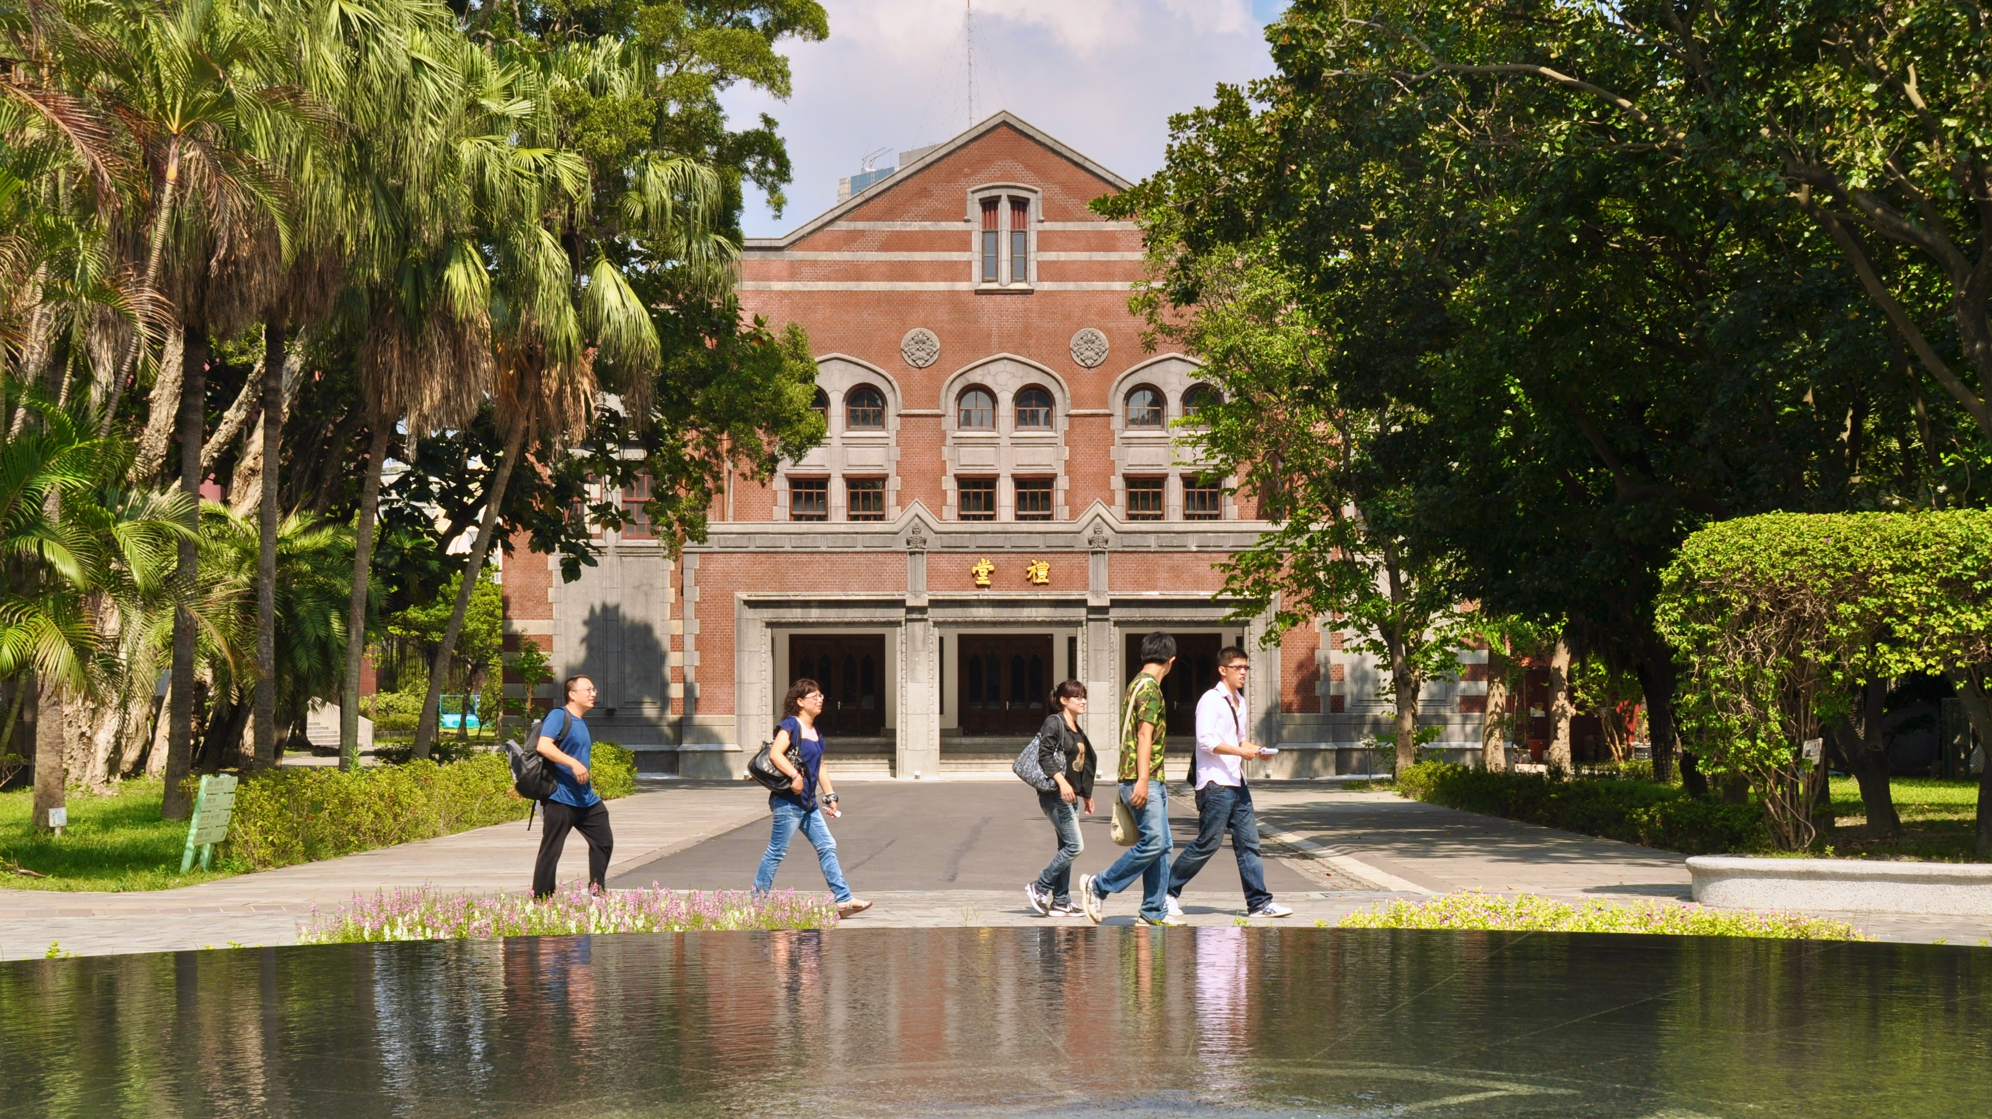
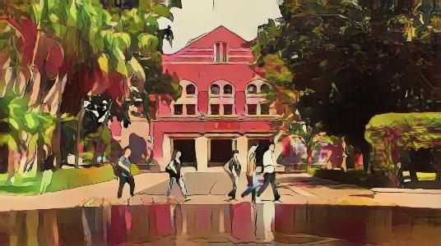
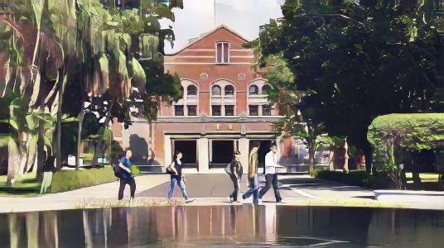
Original
Results
宮崎駿 ver.
新海誠 ver.

Slide 21
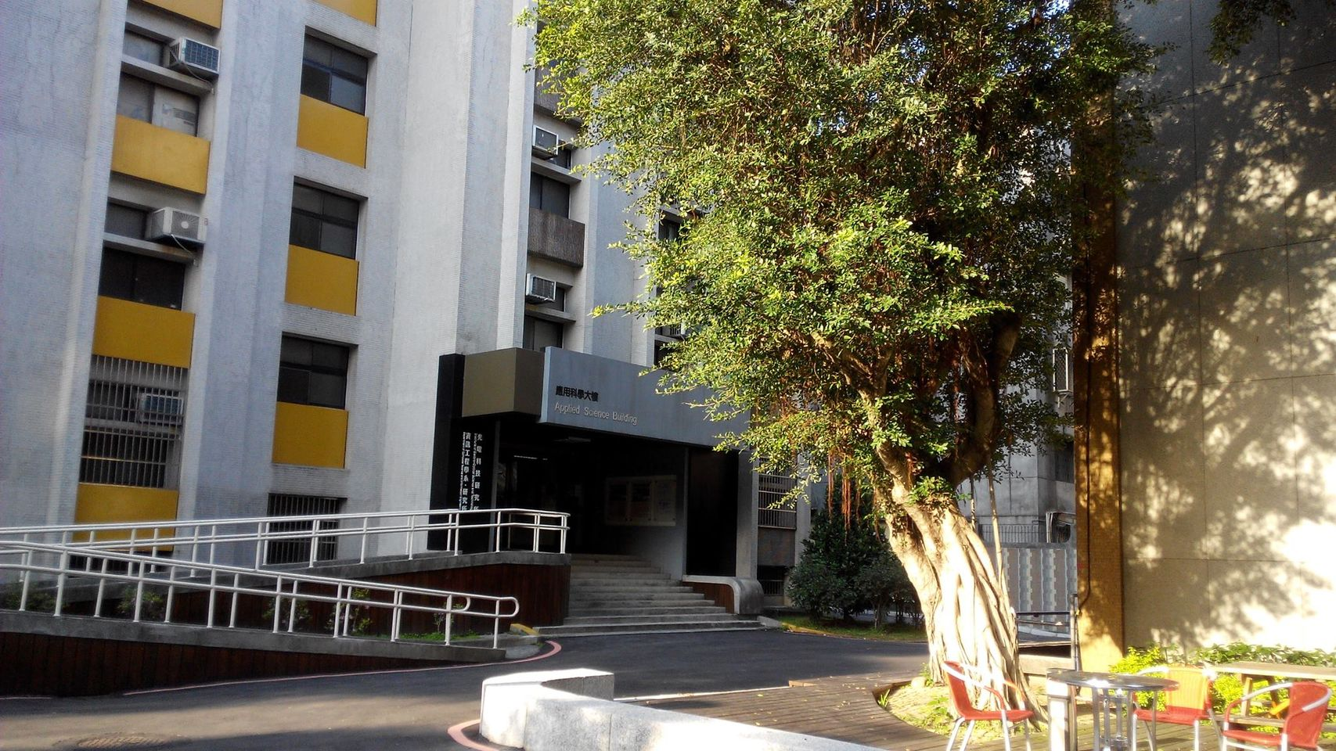
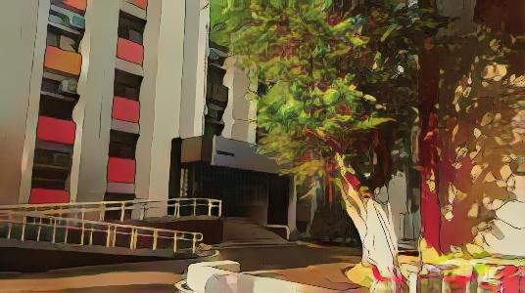
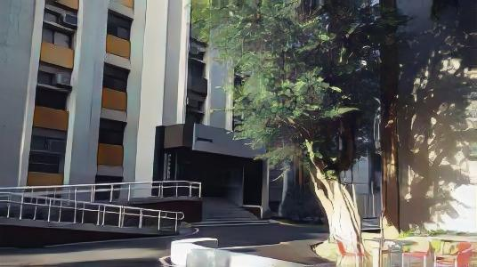
Original
Results
宮崎駿 ver.
新海誠 ver.

Slide 22
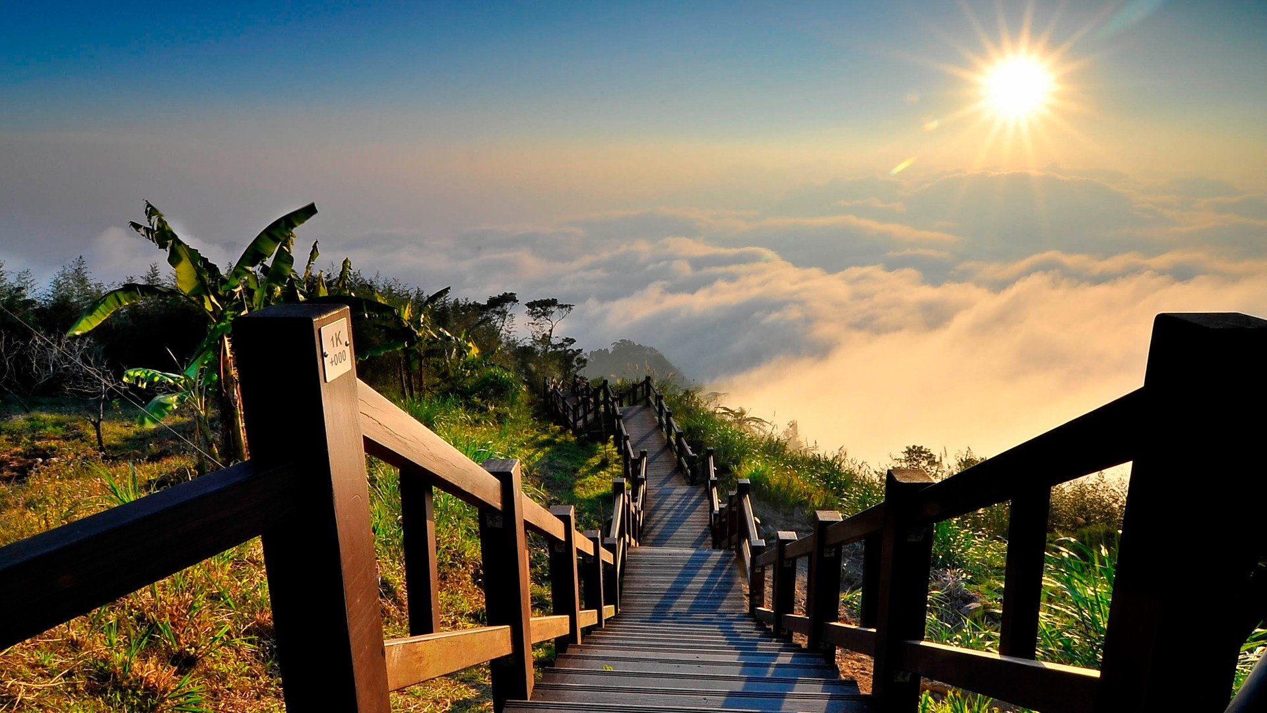
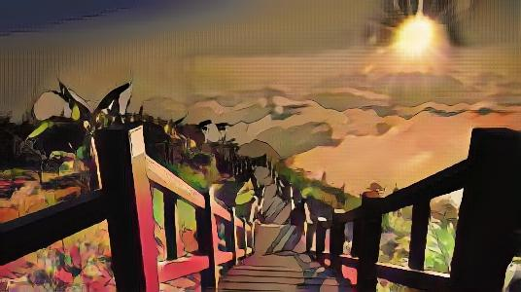
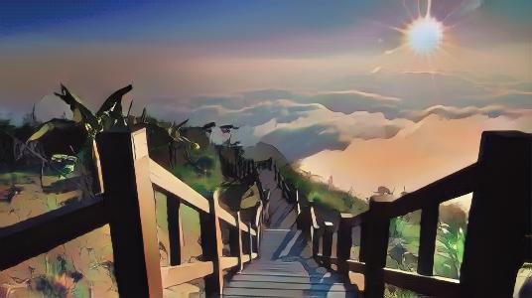
Original
Results
宮崎駿 ver.
新海誠 ver.

Slide 23

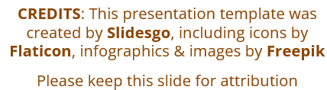
Thanks For Listening

